Slide 1
ADRENERGIC
PHARMACOLOGY
@dr.mansoor(pharmD)

Slide 2
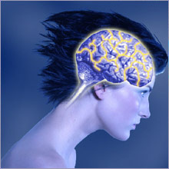
Catecholamines
(dopamine [DA], norepinephrine [NE], epinephrine [EPI])
Synthesis and Metabolism of Catecholamines
Syntheses, storage, release, regulation, receptors

Slide 3
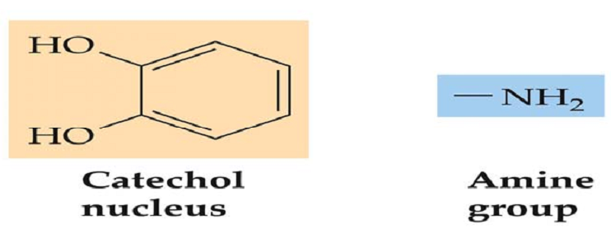
Catecholamines neurotransmitters of
this group share 2 chemical similarities:
one core structure of catechol and an amine group
includes
dopamine (DA),
norepinephrine(NE)/noradrenaline, and
epinephrine (EPI)/adrenaline, and
they are found within the CNS, PNS, and adrenal glands.

Slide 4
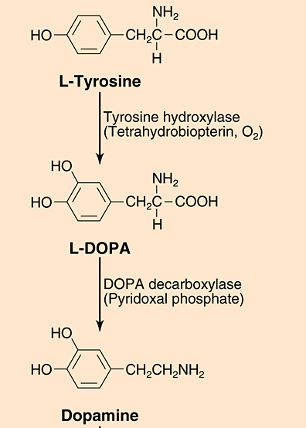
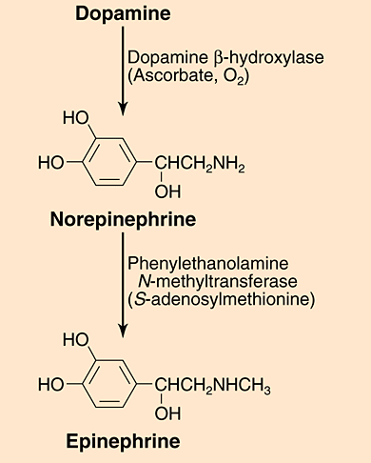
Biosynthesis of Catecholamines
Notes:
Tyrosine is obtained from dietary protein and is transported from the blood into the brain.

Slide 5
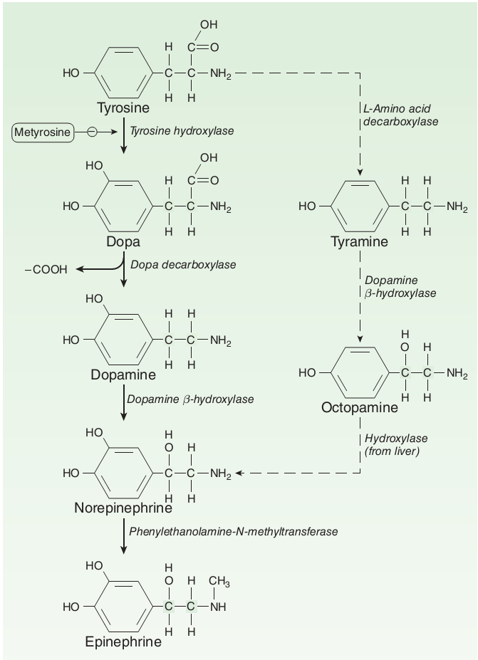

Slide 6
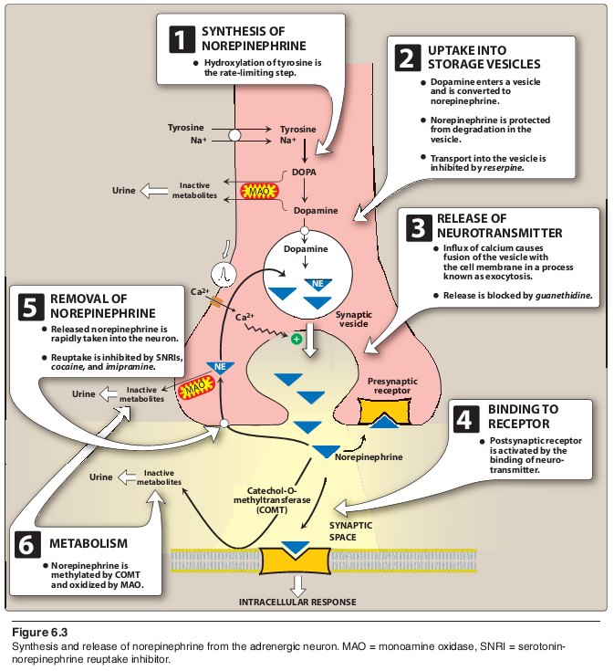
Adrenergic neurons

Slide 7
Neurotransmission at adrenergic
neurons
involves the following steps: synthesis, storage, release, and receptor binding of norepinephrine, followed by removal of the neurotransmitter from the synaptic gap

Slide 8
1: Synthesis of norepinephrine:
Tyrosine is transported by a carrier
into the adrenergic neuron, where it is hydroxylated to dihydroxyphenylalanine (DOPA) by tyrosine hydroxylase.
This is the rate-limiting step in the
formation of norepinephrine.
DOPA is then decarboxylated by the
enzyme aromatic l-amino acid decarboxylase to form dopamine in the presynaptic neuron.
Notes:
Tyrosineis obtained from dietary protein and is transported from the blood into the brain.

Slide 9
Tyrosine hydroxylase catalyzes the rate-limiting step in catecholamine synthesis
the level of catecholamines within the nerve
terminal, e.g., high catecholamine levels within
the nerve terminal tend to inhibit tyrosine
hydroxylase, serving as a negative feedback mechanism.
(2) The rate of cell firing, e.g., when neurons are activated and firing at a high rate, such as during stress, tyrosine hydroxylase would be stimulated.
These elegant mechanisms enable dopaminergic and noradrenergic neurons to carefully control their rate of neurotransmitter formation.

Slide 10
2. Storage of norepinephrine in vesicles:
Dopamine is then transported into synaptic vesicles by an amine transporter system. ((vesiclular monoamine transporter(VMAT)))
This carrier system is blocked by reserpine.

Slide 11
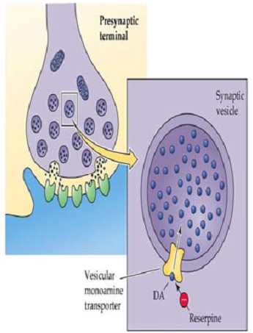
Dopamine is next hydroxylated to form norepinephrine by the enzyme dopa-mine β-hydroxylase.

Slide 12
Vesicular packaging is important because
(1) it provides a means for releasing a predetermined amount neurotransmitter
(~several thousand molecules per vesicle), and
(2) it protects the neurotransmitter from
degradation by enzymes within the nerve terminal.

Slide 13
3. Release of norepinephrine:
An action potential arriving at the
nerve junction triggers an influx of calcium ions from the extracellular fluid into the cytoplasm of the neuron.
The increase in calcium causes
synaptic vesicles to fuse with the cell membrane and to undergo exocytosis to expel their contents into the synapse.
Drugs such as guanethidine block
this release

Slide 14
Psychostimulants, such as amphetamine and methamphetamine, can cause a release of catecholamines independently of nerve cell firing.
Catecholamine depletion: sedation and depressive symptoms
Catecholamine release: behavioral activation

Slide 15
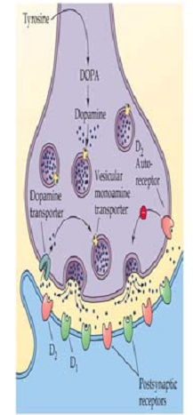
Catecholamine release is inhibited by
Autoreceptors located on the cell bodies,
terminals, and dentrites of dopaminergic and
noradrenergic neurons by reducing the rate of
firing of the cell .
Autoreceptor antagonists tend to enhance
the rate of release by preventing the normal
inhibitory effect of the autoreceptors.

Slide 16
4. Binding to receptors:
Norepinephrine released from the synaptic vesicles diffuses into the synaptic space and binds to postsynaptic receptors on the effector organ or to presynaptic receptors on the nerve ending.
Binding of norepinephrine to receptors triggers a cascade of events within the cell, resulting in the formation of intracellular second messengers that act as links (transducers) in the communication between the neurotransmitter and the action generated within the effector cell.

Slide 17
Adrenergic receptors use both the cyclic adenosine monophosphate (cAMP)
second messenger system and the phosphatidylinositol cycle to
transduce the signal into an effect.
Norepinephrine also binds
to presynaptic receptors (mainly α2
subtype) that modulate the release of the neurotransmitter.

Slide 18
5. Removal of norepinephrine:
Norepinephrine may
1) diffuse out of the synaptic space and enter the systemic circulation;
2) be metabolized to inactive metabolites by catechol-O-methyltransferase (COMT) in the synaptic space; or
3) undergo reuptake back into the neuron.

Slide 19
The reuptake by the neuronal membrane involves a sodium-chloride (Na+/Cl-)-dependent norepinephrine transporter (NET) that can be inhibited by tricyclic antidepressants (TCAs),
such as imipramine, by serotonin–norepinephrine reuptake inhibitors such as duloxetine, or by cocaine.
Reuptake of norepinephrine into the presynaptic neuron is the primary mechanism for termination of its effects.

Slide 20
6. Potential fates of recaptured NE
Once norepinephrine reenters the adrenergic neuron,
it may be taken up into synaptic vesicles via the amine transporter system and be sequestered for release by another action potential, or it may persist in a protected pool in the cytoplasm.
Alternatively, norepinephrine can be oxidized by monoamine oxidase (MAO) present in neuronal mitochondria.

Slide 21
Catecholamine inactivation occurs through a combination of reuptake and metabolism
Metabolic breakdown: There are two enzymes
mainly involved in the breakdown of catecholamines, catechol-O-methyltransferase (COMT) and monoamine oxidase (MAO).
dopamine has one major metabolite,
homovanillic acid (HVA).
Norepinephrine has two major
metabolites, 3-methoxy-4-hydroxy-phenylglycol (MHPG) and vanillymandelic acid (VMA).
MAO inhibitors: the treatment of depression.
COMT inhibitors: as a supplemental therapy to
enhance the effectiveness of L-DOPA in treating Parkinson’s disease.

Slide 22
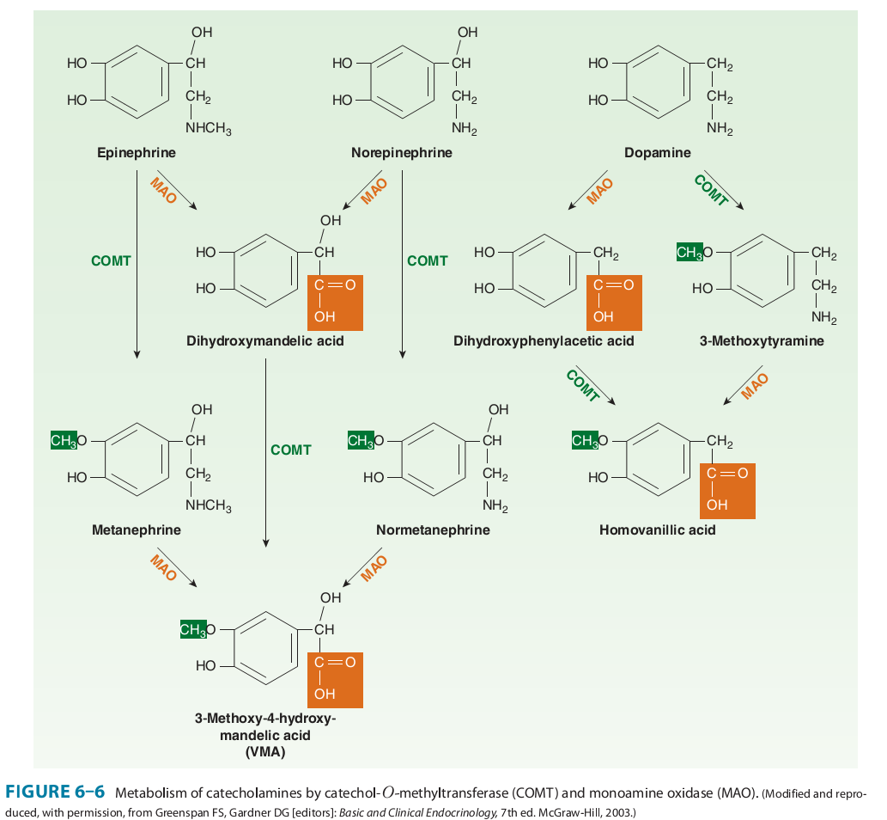

Slide 23
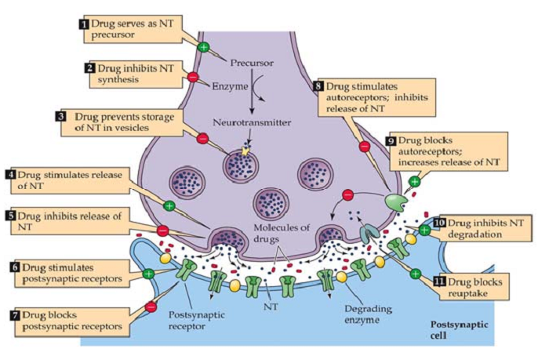
Summary of the mechanisms by which drugs can alter synaptic transmission

Slide 24
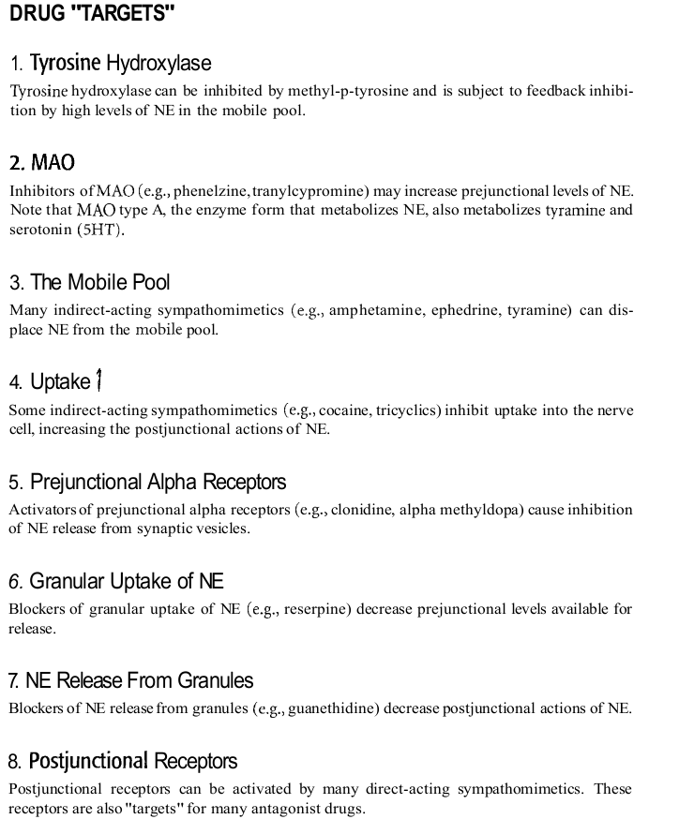

Slide 25
Classification of Adrenoceptors:
The expressions "adrenoreceptor", "adrenoceptor" and "adrenergic receptor" are synonymous.
Most people reserve the term "adrenoreceptor" for a1, a2, b1, b2, and b3-receptors.
The D receptors are dopamine receptors and are highly relevant to behavior and to Parkinson’s disease and will be treated only briefly in this lecture.
Two main families of receptors, designated α
and β, are classified on the basis of their responses to the adrenergic agonists epinephrine, norepinephrine, and isoproterenol.

Slide 26
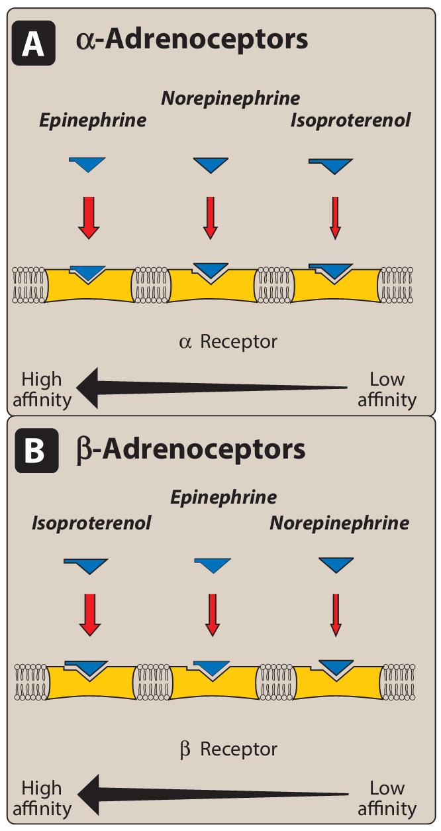

Slide 27
Each of these main receptor types has a number of specific
receptor subtypes that have been identified.
all belong to the superfamily of G-protein-coupled receptors
Alterations in the primary structure of the receptors influence their affinity for various agents
a1 (three subtypes): a1A , a1B , a1C
a2(three subtypes): a2A, a2B, a2C
b1
b2
b3
D1, D2, D3, D4, D5

Slide 28
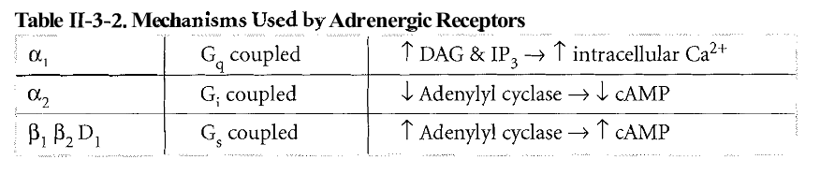
Second messengers:
α1-receptors activate phospholipase C, producing inositol trisphosphate and diacylglycerol as second messengers
α2-receptors inhibit adenylate cyclase, decreasing cAMP formation
all types of β-receptor stimulate adenylyl cyclase.

Slide 29
α-Adrenoceptors:
show a weak response to the synthetic agonist isoproterenol,
but they are responsive to the
naturally occurring catecholamines epinephrine and norepinephrine
For αreceptors, the rank order of potency and affinity is epinephrine ≥ norepinephrine>> isoproterenol.

Slide 30
α1Receptors:
present on the postsynaptic membrane of the effector organs and mediate many of the classic effects, originally designated as α-adrenergic, involving constriction of smooth muscle.
Activation of α1 receptors initiates a series of reactions through the G protein activation of phospholipase C, ultimately resulting in the generation of second messengers inosi-tol-1,4,5-trisphosphate (IP3) and diacylglycerol (DAG).
IP3 initiates the release of Ca2+ from the endoplasmic reticulum into the cytosol, and DAG turns on other proteins within the cell

Slide 31
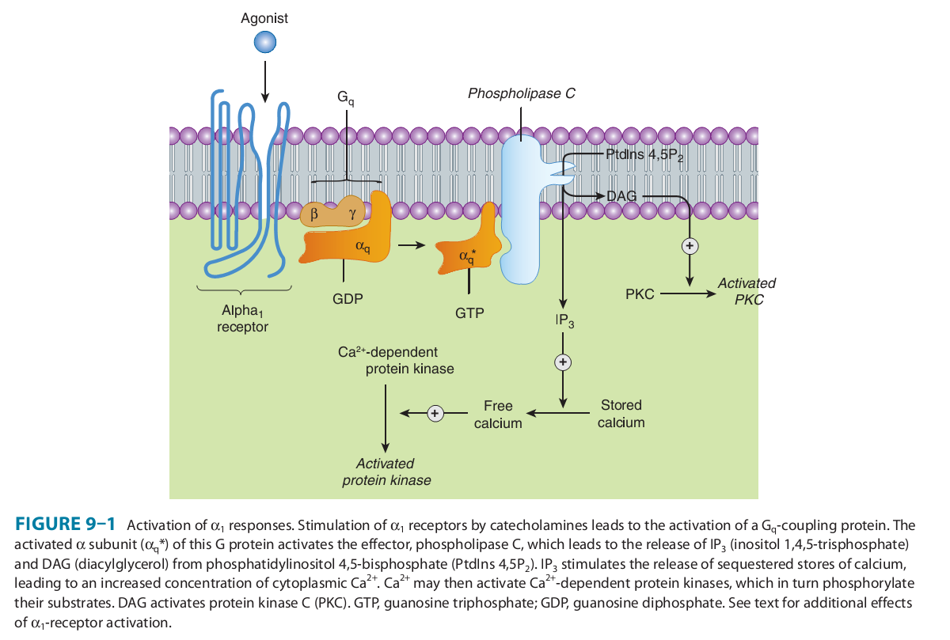

Slide 32
b. α2 Receptors:
located primarily on sympathetic presynaptic nerve endings and control the release of norepinephrine.
When a sympathetic adrenergic nerve is stimulated, a portion of the released norepinephrine “circles back” and reacts with α2 receptors on the presynaptic membrane
Stimulation of α2 receptors causes feedback inhibition and inhibits further release of norepinephrine
NE can diffuse to and interact with these receptors, inhibiting acetylcholine release.

Slide 33
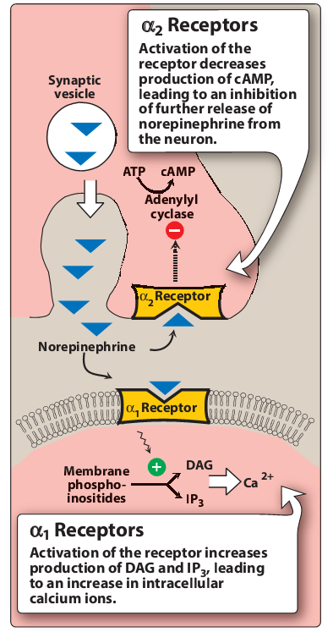

Slide 34
β-Adrenoceptors:
characterized by a strong response to isoproterenol, with less sensitivity to epinephrine and norepinephrine
the rank order of potency is isoproterenol> epinephrine> norepinephrine.
The β-adrenoceptors can be subdivided into three major subgroups, β1, β2, and β3, based on their affinities for adrenergic agonists and antagonists.

Slide 35
β1receptors have approximately equal affinities for epinephrine and norepinephrine, whereas β2 receptors have a higher affinity for epinephrine than for norepinephrine.
β2 receptors are mostly not innervated
Thus, tissues with a predominance of β2 receptors (such as the vasculature of skeletal muscle) are particularly responsive to the effects of circulating epinephrine released by the adrenal medulla.

Slide 36
Β3 receptors are involved in lipolysis and also have effects on the detrusor muscle of the bladder.
Binding of a neurotransmitter at any of the three types of βreceptors results in activation of adenylyl cyclase and increased concentrations of cAMP within the cell.

Slide 37
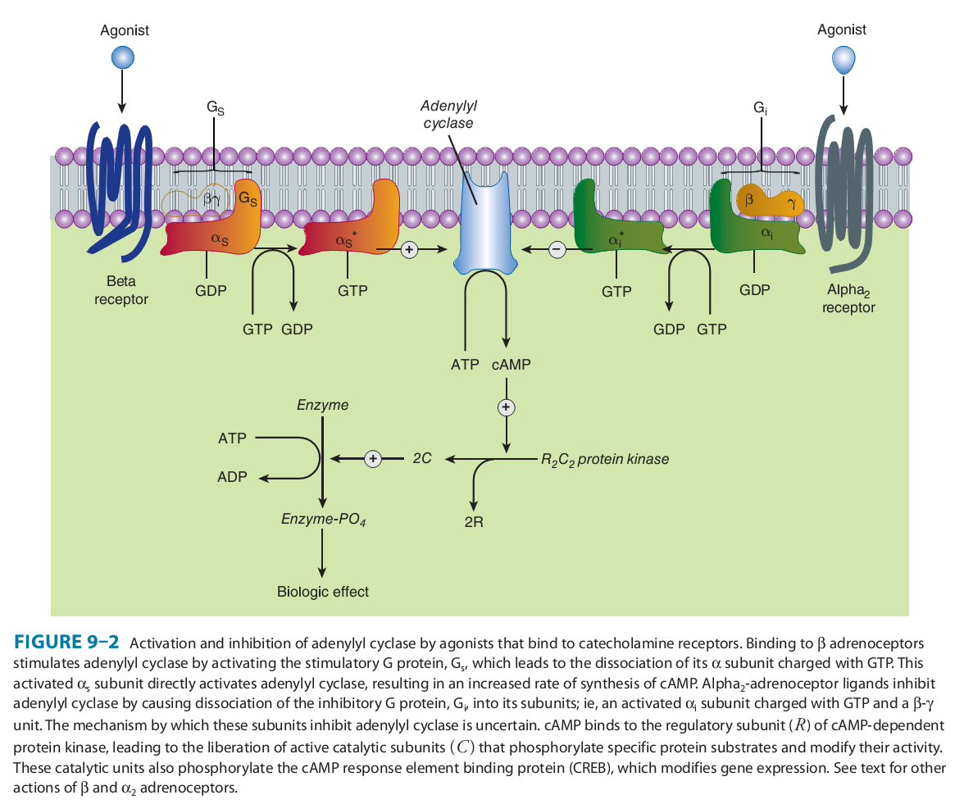

Slide 38
Distribution of receptors:
Adrenergically innervated organs and
tissues usually have a predominant type of receptor.
For example,
tissues such as the vasculature of skeletal muscle have both α1 and β2 receptors, but the β2 receptors predominate.
Other tissues may have one type of receptor almost exclusively. For example, the heart contains predominantly β1receptors.

Slide 39
The main effects of receptor activation are as follows.
α1-receptors:
vasoconstriction, relaxation of gastrointestinal smooth muscle, salivary secretion and hepatic glycogenolysis
α2-receptors:
inhibition of transmitter release (including noradrenaline and acetylcholine release from autonomic nerves), platelet aggregation, contraction of vascular smooth muscle, inhibition of insulin release

Slide 40
β1-receptors:
increased cardiac rate and force
β2-receptors:
bronchodilatation, vasodilatation, relaxation of visceral smooth muscle, hepatic glycogenolysis and muscle tremor
β3-receptors:
lipolysis.

Slide 41
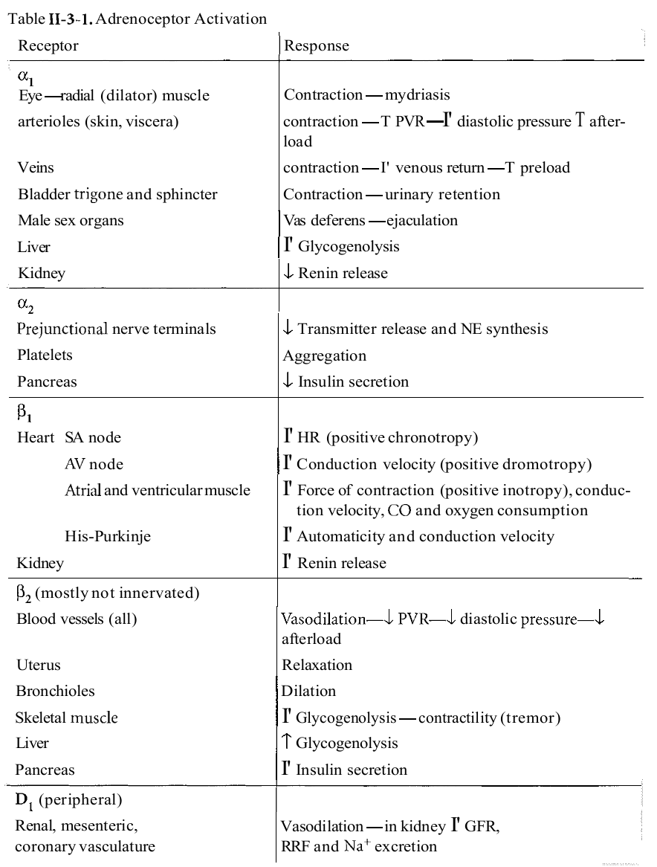

Slide 42
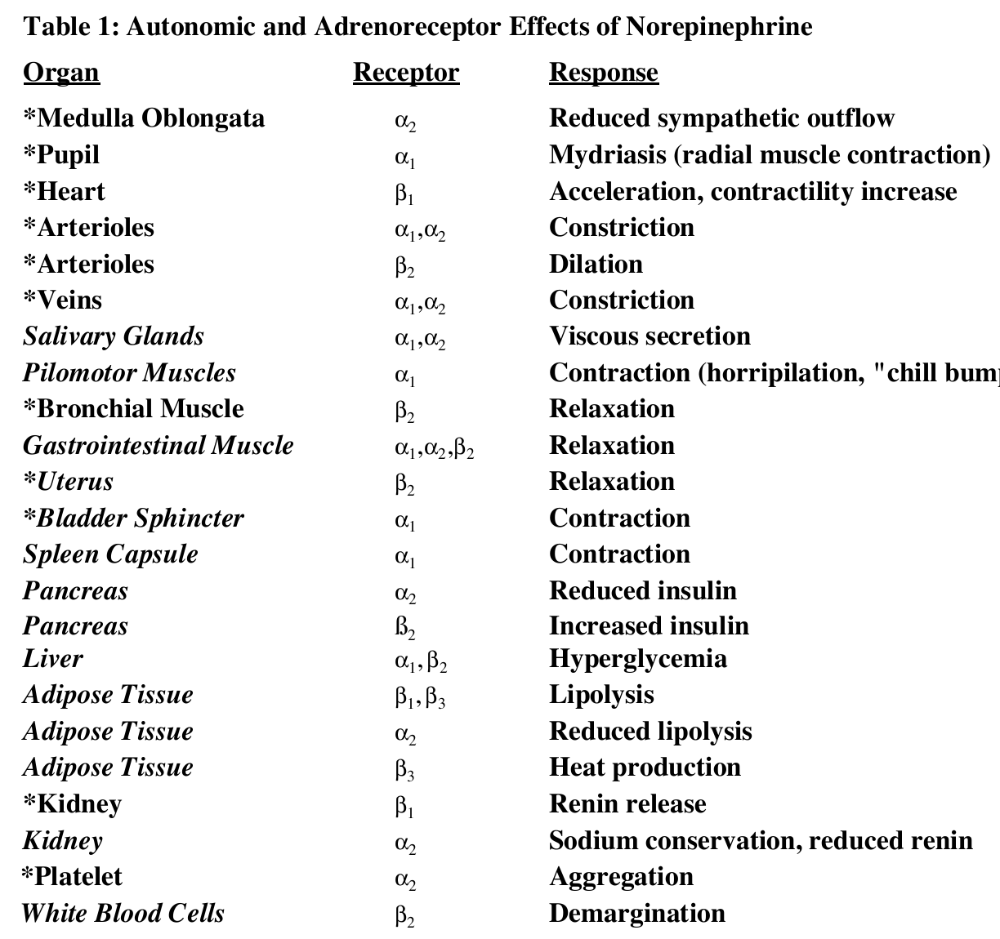

Slide 43
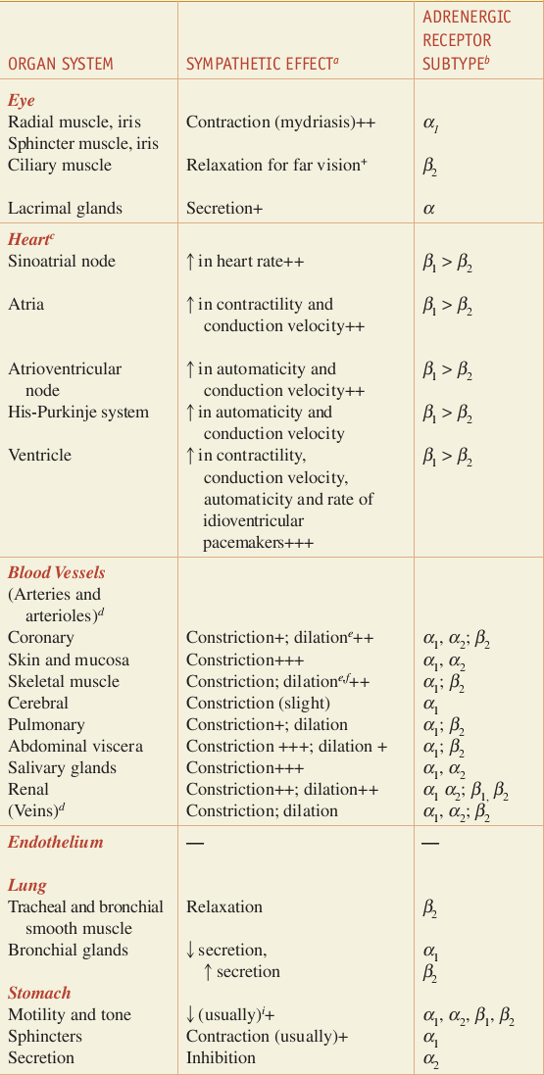

Slide 44
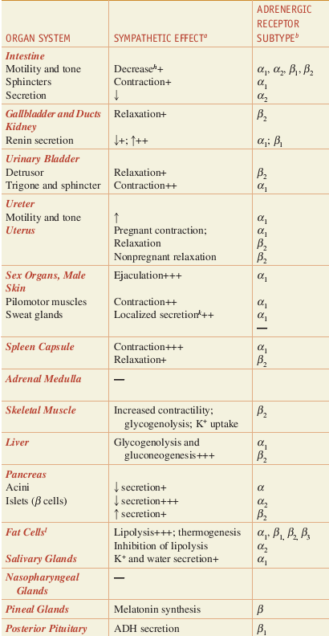

Slide 45
Desensitization of receptors:
Prolonged exposure to the catecholamines reduces the responsiveness of these receptors,
Three mechanisms have
been suggested to explain this phenomenon:
1) sequestration of the receptors so that they are unavailable for interaction with the
ligand;
2) down-regulation, that is, a disappearance of the receptors either by destruction or by decreased synthesis; and
3) an inability to couple to G protein, because the receptor has been phosphorylated on the cytoplasmic side.

